Slide 1
Azure Service Fabric Container Services High Availability Services
Alexey Bokov
Technical Evangelist, Microsoft
September 2016

Slide 2
Contents
Common considerations about technology choices
Azure Container Service – Docker containers orchestration in cloud
Service Fabric crash course
High Availability and Disaster Recovery in Azure:
Azure DNS - cloud API for DNS records hosting
Traffic Manager – load balancing and fault-tolerance on DNS level
Azure Load Balancer – load balancing on transport level
Application Gateway – load balancing on application level
5) Azure Batch for computational tasks
6) VM Scale sets
6) Storage - managed disks and cool storage

Slide 3

Decision Tree
New Code?
AD?
Just Files and Network?
Microservice : statefull, stateless, agent
VM
Guest
Container
* Preview
Service Fabric (Azure or on prem)
Other Container Platforms

Slide 4
Application Guidance
1
Statefull/stateless/agent Microservices: whenever possible
Suite of powerful management APIs available
Suite of powerful persistent data APIs available. No more DB.
Bring the work to the data (partitioning/sharding)
2
Guest Microservices: when legacy app does not require full OS services
Requires only files and network
No registry
No Eventlog
3
Container: when legacy app requires full OS services
4
VMs: Build up no new VMs. Migrate from on prem if you must (i.e. for AD). Convert VMs to containers when possible

Slide 5
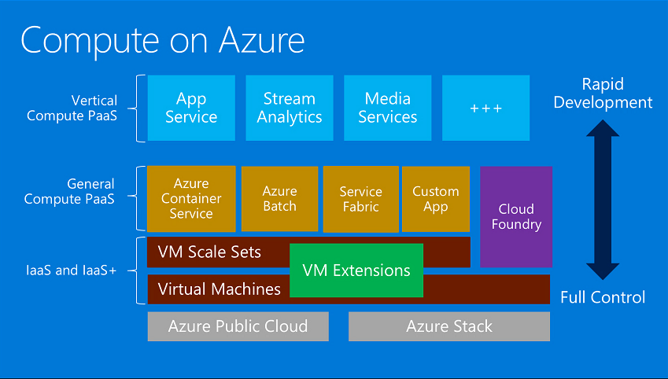
Services map

Slide 6
Containers and virtual machines Deployment options suited to many scenarios
Virtual Machine
Spotlight capabilities
Container
Containers in VMs: By combining containers with VMs, users can deploy multiple, different VM operating systems, and inside, deploy multiple containers within those guest OSs.
By combining containers with VMs, fewer VMs would be required to support a larger number of apps.
Fewer VMs would result in a reduction in storage consumption.
Each VM would support multiple isolated apps, increasing overall density.
Flexible: Running containers inside VMs enables features such as live migration for optimal resource utilization and host maintenance.
App A Bins/Libraries
App A Bins/Libraries
App B Bins/Libraries
Guest OS
Guest OS w/ Container Support
Hypervisor
Server

Slide 7
App A
App A’
App B
Containers are isolated, but share OS and, where appropriate, bins/libraries
Bins/Libs
Bins/Libs
Bins/Libs
Guest OS
Guest OS
Guest OS
App A
App A’
App B
App B’
App B
App B’
App B
App B’
Bins/Libs
Bins/Libs
Hypervisor
Docker Engine
Host OS
Host OS
Server
Server

Slide 8



Docker integration Joint strategic investments to drive containers forward
Docker Hub in Azure: Huge collection of open and curated applications available for download
Collaboration: Bring Windows Server containers to the Docker ecosystem to expand the reach of both developer communities
Docker Engine: Docker Engine for Windows Server containers will be developed under the aegis of the Docker open source project
Docker client: Windows customers will be able to use the same standard Docker client and interface on multiple development environments
Docker Client
Docker.exe
Examples:
docker run
docker images
Windows Server
Linux
Docker Remote API
Examples:
GET images/json
POST containers/create
Docker Engine
(Daemon)
Docker Engine
(Daemon)
Windows Server
Container Support
Linux Container
Support (LXC)

Slide 9
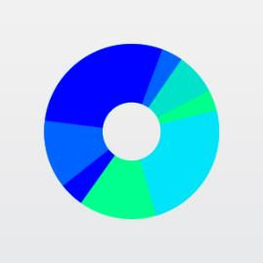


Orchestration Solutions Orchestration Management
Swarm Compose
Marathon
Cloud
Cloud

Slide 10
Azure Container Service is all about to provide a container hosting environment.
We expose the standard API endpoints for your chosen orchestrator (DC/OS or Docker Swarm).
By using these endpoints, you can leverage any software that is capable of talking to those endpoints.
For Docker Swarm endpoint, you might choose to use the Docker command-line interface (CLI).
For DC/OS (use Apache Mesos) , you might choose to use the DCOS CLI.
Notes:
Mesos now provides more advanced scheduling as well as fault tolerance
But now it’s getting really complicated to configure my environment:
Docker CLI
Docker Machine
Docker Host with Docker Engine
Docker containers
Apache Mesos
Docker Swarm
(and the diagram doesn’t even include the required registry and multiple masters with Apache Zookeeper that you would use in production, we’re also ignoring the need to monitor what is happening – more on monitoring soon)

Slide 11
Azure Container Service
Azure Container Service (ACS) is a container hosting environment optimized for Azure. ACS simplifies container-based application development and deployment. Leveraging the best of partner technologies such as Docker, Apache Mesos and open source components of DCOS, we free your teams to focus on application development rather than dev/test and deployment infrastructure.
ACS is a free service that clusters Virtual Machines (VMs) into a container service. You only pay for the VMs and associated storage and networking resources consumed.
ACS clusters are composed of masters and agents.
Masters provide container orchestration and deployment management.
Agents provide the computing power for your workload.
A single cluster must include a minimum of three virtual machines: one master, one public agent and one private agent. For HA you are recommended to deploy either three or five masters to your ACS cluster.
Masters always use D2-size virtual machines, but for agents you can select any size VM
All agents in a single ACS cluster must use the same size virtual machine regardless of whether they are designated as public or private.
The cost of a single ACS cluster is calculated by summing the price masters and agents.

Slide 12
Azure Container Service – FAQ
At this time ACS does not provide autoscaling, though we are built on VM Scale Sets. In the future you will be able to use the autoscale features of VMSS but we don't currently have a fixed date for this. In the meantime you must manually scale the cluster.
ACS makes sense with clusters: single VM acting as a Docker host you shouldn't use ACS - using other solutions such as Ubuntu with Docker or docker-machine using the Azure driver. ACS is designed for larger use cases in which multiple Docker hosts are present and thus orchestration is necessary.
ACS creates it's own, self-contained, virtual network. ( you can’t create it inside your existing network currently )
To change/regen SSH – you need to go to master node
Currently only Linux, WS2016 is on private preview
Not possible to run it in PaaS like mode
Currently only Docker containerization supported, Kubernetes and others _may_be_later_

Slide 13
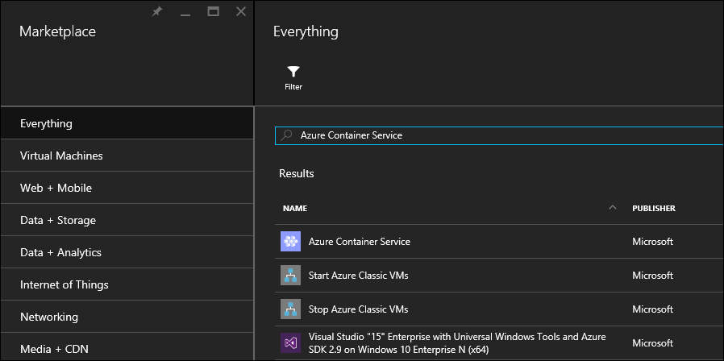
ACS: how to create
Sign in to the Azure portal, select New, and search the Azure Marketplace for Azure Container Service
Create and Configure ACS basics:
User name: each VM and scale set will use that username
Subscription: Select an Azure subscription.
Resource group: Select an existing resource group, or create a new one.
Location: Select an Azure region for the Azure Container Service deployment.
SSH public key

Slide 14
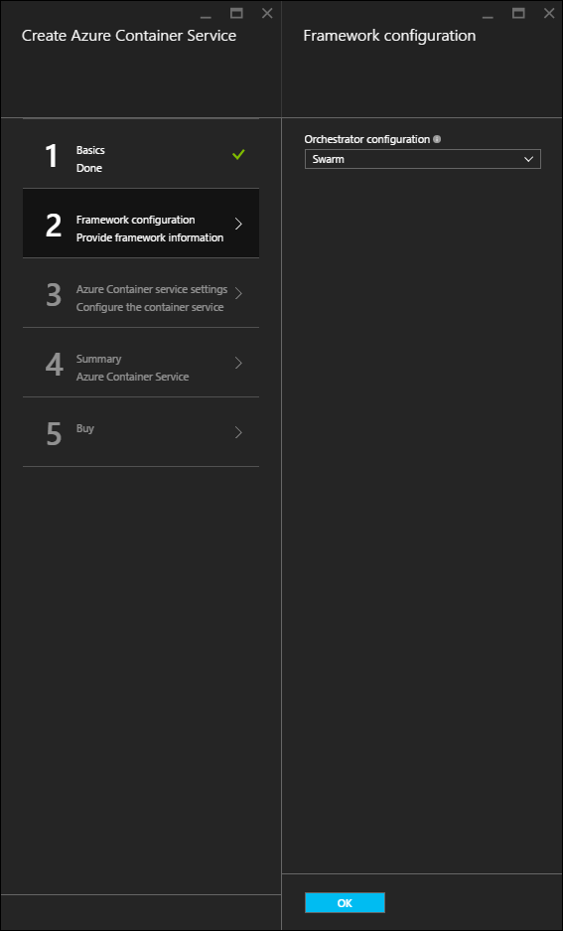
ACS: how to create
You have choice between Docker Swarm and DC/OS ( based on Apache Mesos )

Slide 15
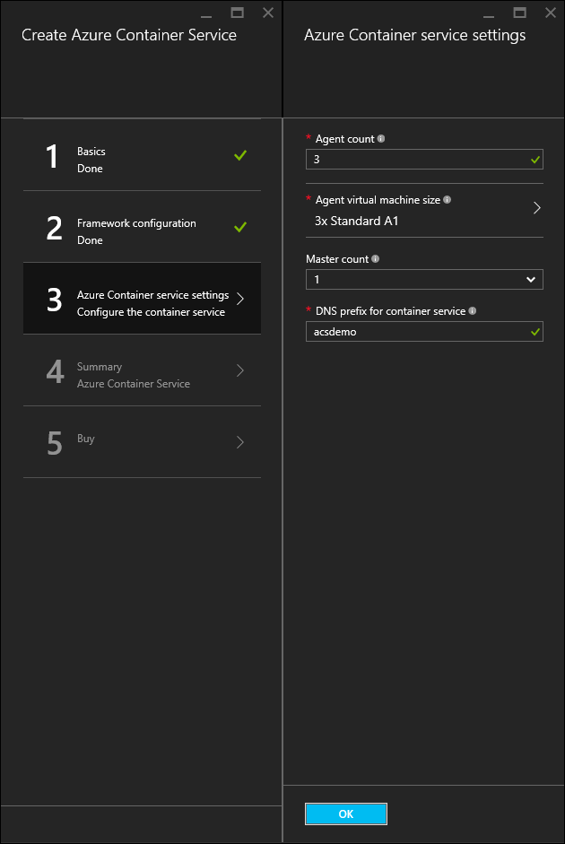
ACS: how to create
Master count: The number of masters in the cluster.
Agent count:
Docker Swarm, this will be the initial number of agents in the agent scale set.
DC/OS: initial number of agents in a private scale set. Public scale set is created, which contains a predetermined number of agents (one public agent for one master, and two public agents for three or five masters ).
Agent virtual machine size: The size of the agent
virtual machines.
DNS prefix: prefix key parts of the FQDN(fully
qualified domain names) for the service

Slide 16
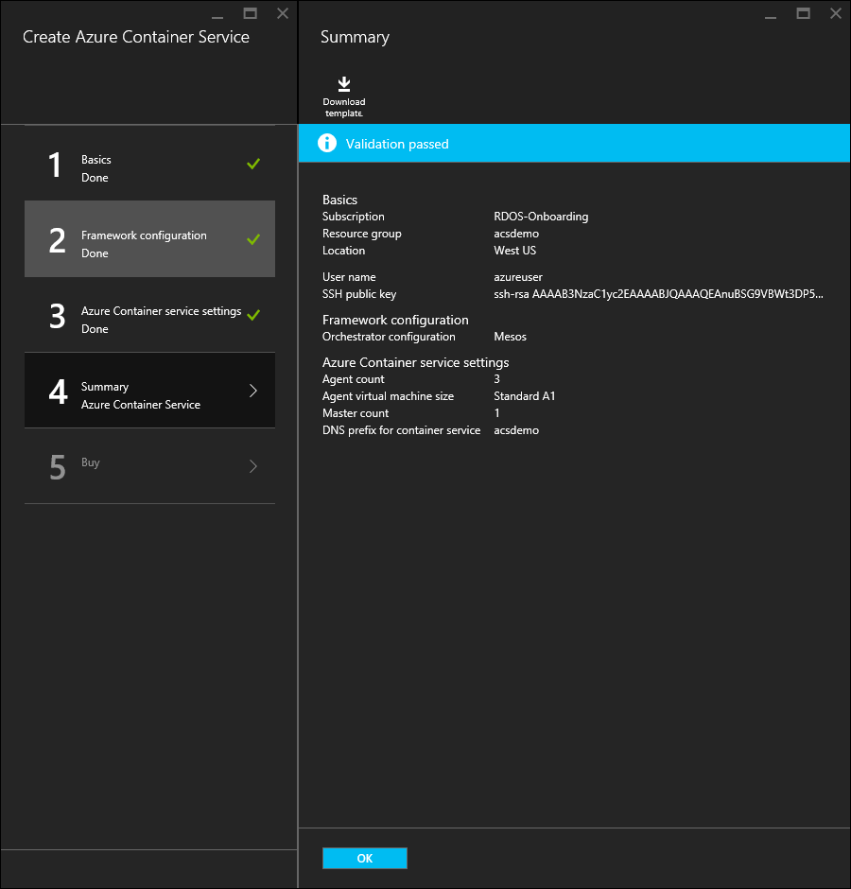
ACS: how to create
Review summary

Slide 17
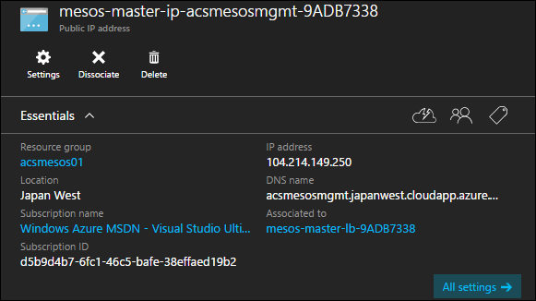
ACS: connect to cluster – create SSH tunnel
Find public DNS name of load-balanced masters from Azure portal (see picture below), create SSH tunnel
PORT is the port of the endpoint that you want to expose. For Swarm, this is 2375. For DC/OS, use port 80. USERNAME/DNSPREFIX/REGION is params were provided when you deployed the cluster. PATH_TO_PRIVATE_KEY - private key from the public key you provided when you created the ACS cluster
ssh -L PORT:localhost:PORT -f -N [USERNAME]@[DNSPREFIX]mgmt.[REGION].cloudapp.azure.com -p 2200
#The SSH connection port is 2200--not the standard port 22.
#With private key use –i flag

Slide 18
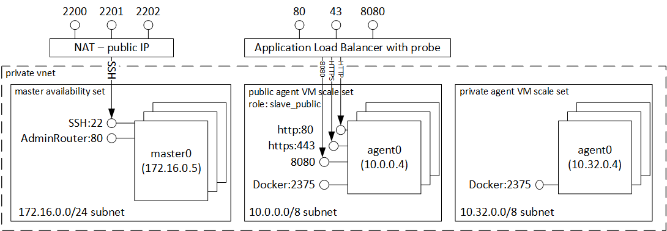
ACS: open DC/OS tunnel
sudo ssh -L 80:localhost:80 -f -N azureuser@acsexamplemgmt.japaneast.cloudapp.azure.com -p 2200
You can now access exposed REST API and endpoints:
DC/OS: http://localhost/
Marathon: http://localhost/marathon
Mesos: http://localhost/mesos

Slide 19
Azure Container Service:DC/OS (Apache Mesos )
Proven scalability
Fault-tolerant replicated master and slaves using Apache ZooKeeper
Support for Docker-formatted containers
Native isolation between tasks with Linux containers
Multiresource scheduling (memory, CPU, disk, and ports)
Java, Python, and C++ APIs for developing new parallel applications
A web UI for viewing cluster state
By default includes Marathon orchestration platform for scheduling workloads
….

Slide 20
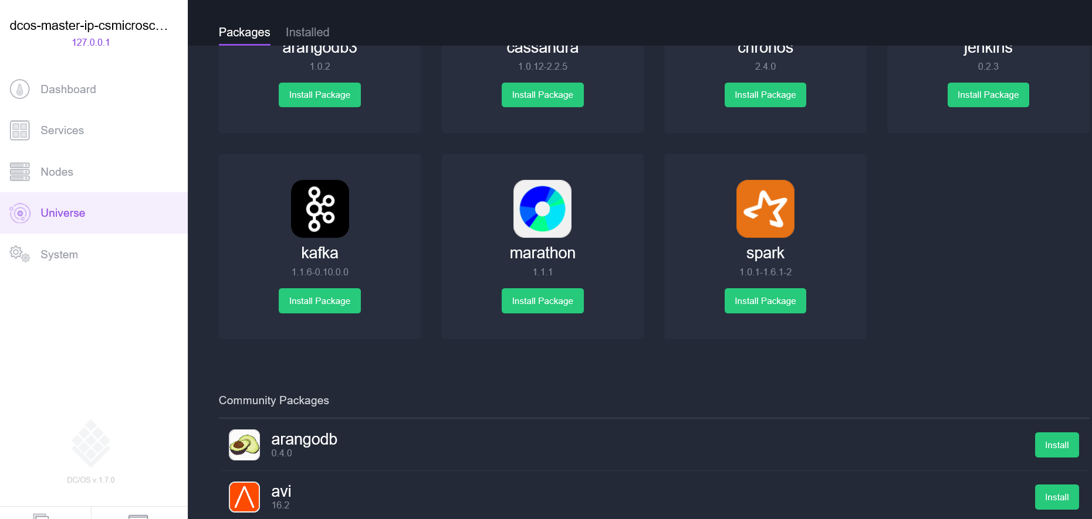
Azure Container Service:DC/OS (Apache Mesos )
By default includes Marathon orchestration platform for scheduling workloads
Included with the DC/OS deployment of ACS is the Mesosphere Universe of services that can be added to your service ( Spark, Hadoop, Cassandra, etc )

Slide 21
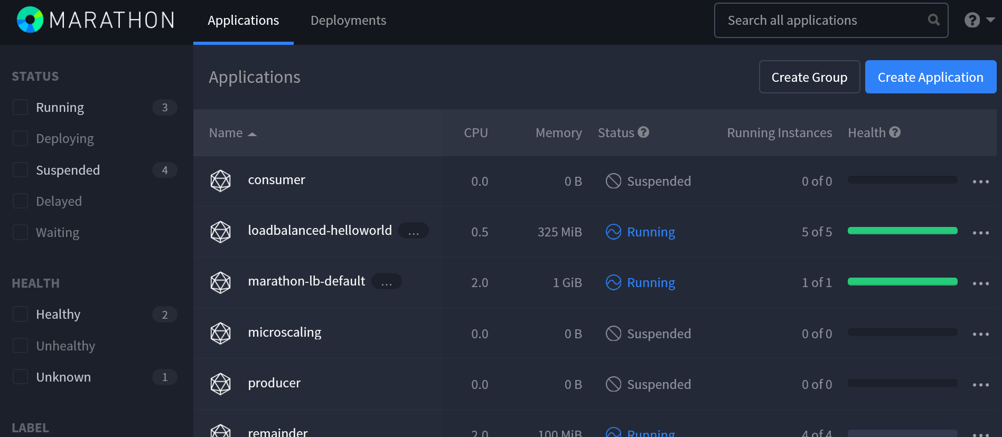
ACS:DC/OS with Marathon
Marathon is a cluster-wide init and control system for Azure Container Service, Docker-formatted containers
Marathon provides REST API and web UI : http://DNS_PREFIX.REGION.cloudapp.azure. ( com DNS_PREFIX and REGION are both defined at deployment time )

Slide 22
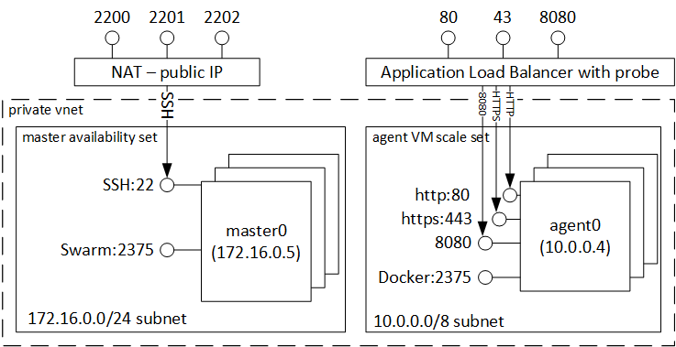
ACS: open Docker Swarm
ssh -L 2375:localhost:2375 -f -N azureuser@acsexamplemgmt.japaneast.cloudapp.azure.com -p 2200
You can set your DOCKER_HOST environment variable as follows. You can continue to use your Docker command-line interface (CLI) as normal
export DOCKER_HOST=:2375

Slide 23
Azure Container Service:Docker Swarm
Docker Swarm provides native clustering for Docker.
Docker Swarm serves the standard Docker API.
Any tool that already communicates with a Docker daemon can use Swarm to transparently scale to multiple hosts on Azure Container Service:
Dokku
Jelastic
Docker CLI and Docker Compose

Slide 24
Azure Container Services
Layer | Supported Technologies in MVP (2015)
Configuration as Code | ARM, Dockerfile, Docker Compose
Host cluster management | VM Scale Sets
Container orchestration | Docker Swarm, Chronos, Marathon, Apache Mesos
Monitoring | OMS
Storage
Container networking
Security
DevOps pipeline
Identity
Tooling integration
Service Tooling
Container Tooling
ARM Template
Containers
Container Services (1st party, 3rd party)
Windows Server
Linux
VMs and VM Scale Sets
Azure Stack
Azure
Notes:
Azure Stack and Azure provides the foundations
VMs provide the initial unit of computation for management purposes
Windows Server and Linux provide the OS for those VMs and allow BYO management software
Today we offer containers, managed by Docker compatible Container tooling
The infrastructure is hand crafted using ARM templates
Azure Container Services will ease the management of 1st and 3rd party container technologies
We are taking a layered approach to providing these services

Slide 25
Hyper-V Containers
Anatomy and key capabilities
Hyper-V Container
Hyper-V Container
Consistency: Hyper-V containers use the same APIs Windows Server Containers ensuring consistency across management and deployment toolsets
Compatibility: Hyper-V Containers use the exact same images as Windows Server Containers
Strong isolation: each Hyper-V Container has it’s own dedicated copy of the kernel
Highly trusted: built with proven Hyper-V virtualization technology
Optimized: the virtualization layer and the operating system have been specifically optimized for containers
App A Bins/Libraries
App B Bins/Libraries
Windows Guest OS Optimized for Hyper-V Container
Windows Guest OS Optimized for Hyper-V Container
Hypervisor
Server

Slide 26
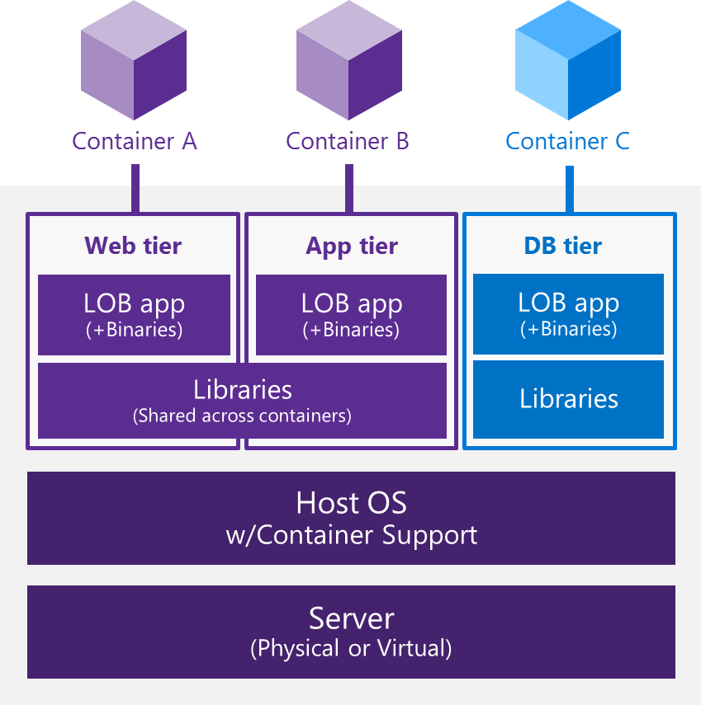
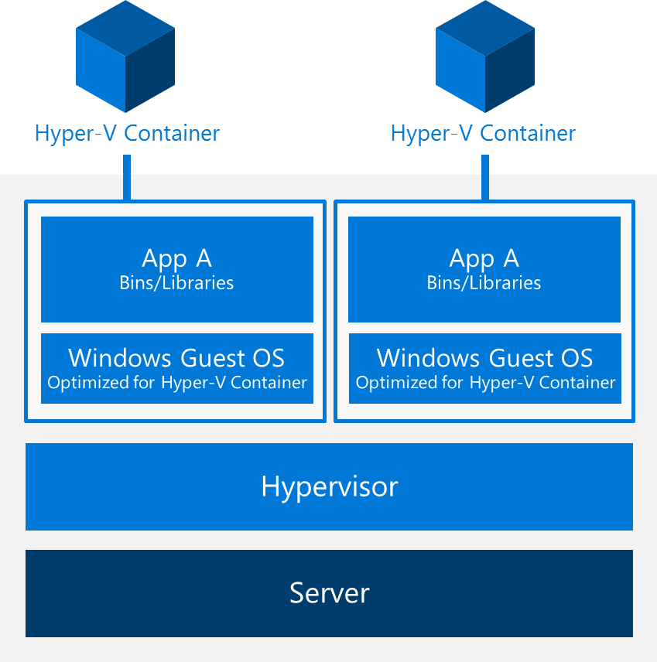
Windows Server and Hyper-V Containers
Windows Server Container Bring the agility and density of containers to the Windows ecosystem, enabling agile application development and deployment
Hyper-V Container Offer a unique additional level of isolation for sensitive applications with no additional coding required
Windows Server Container
Hyper-V Container

Slide 27
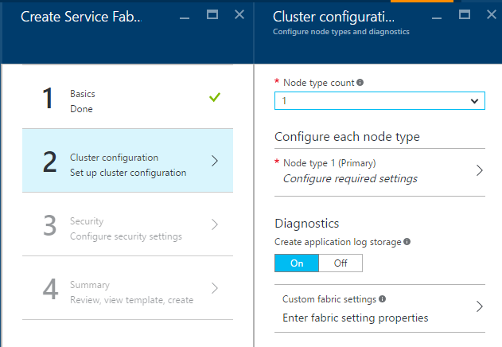
Service Fabric Overview
Distribute/Manage/Scale your services
Service Fabric components are free of charge
Supported clouds (Windows, soon Linux)
Microsoft: Azure & Azure Stack
Other: On-premises & other public clouds
OneBox: Development PC (via SF SDK)
Programming models
Guest executables: Any Windows app (any language & frameworks)
Service host executables: Reliable Services (.NET)
Notes:
Works in hybrid scenarios – supporting azure stack
Easy to get started, tutorials to create simple apps in visual studio
Phenomenal growth – heavy enterprise adoption.

Slide 28
What can you build with Service Fabric?
Stateless services
A service that has state where the state is persisted to external storage, such as Azure databases or Azure storage
Existing web (ASP.NET) and worker role applications
Stateful services
Reliability of state through replication and local persistence
Reduces latency
Reduces the complexity and number of components in traditional three tier architecture
Existing apps written with other frameworks
node.js, Java VMs, any EXE

Slide 29
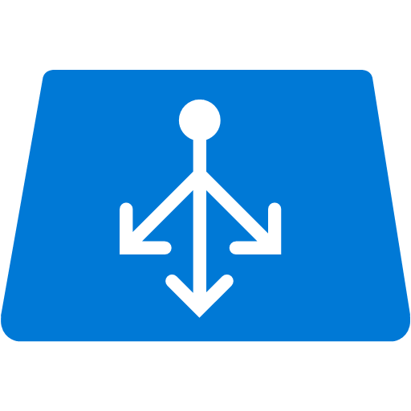


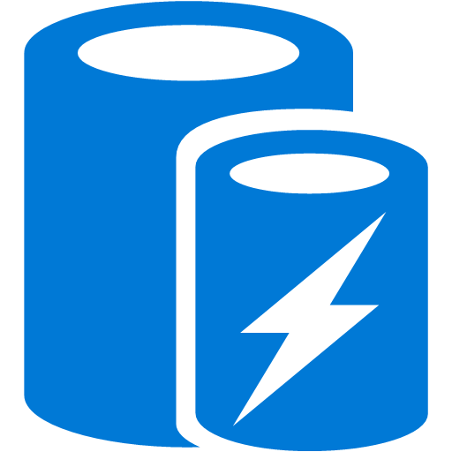


Stateless Services Pattern
Load Balancer
Scale stateless services backed by partitioned storage
Increase reliability and ordering with queues
Reduce read latency with caches
Manage your own transactions for state consistency
More moving parts each managed differently
Front End
(Stateless
Web)
Stateless
Middle-tier
Compute
Cache
Queues Storage
Notes:
<build slide>

Slide 30

Stateful Services Pattern Simplify design, reduce latency
Load Balancer
Application state lives in the compute tier
Low Latency reads and writes
Partitions are first class at the service layer for scale-out
Built in transactions
Fewer moving parts
External stores for exhaust and offline analytics
Front End
(Stateless
Web)
Stateful
Middle-tier
Compute
Cold Data Stores
For Exhaust
(Optional)
Notes:
<build slide>
All first party services are stateful

Slide 31
Example Cloud Services Built On Service Fabric
Service | Description
Azure Database | Scale-out relational database
Halo | Hot gaming in Xbox and Windows 10
Azure Power BI | BI Pro Data Analysis Services
Azure Networking | Regional Network Manager (RNM) for cross cluster/DC VNET
Azure Compute and Networking | Resource Providers for Compute (CRP), Networking (NRP), Storage (SRP)
Azure DocumentDB | No-SQL store for JSON documents Integrated with O365
Service Bus | Service Bus Resource Provider (SBRP)
Intune | Unified management of PCs and devices on the cloud.
Bing Cortana | Personal assistant
In production for five years
We’re giving you the same bits we run!
Notes:
！！ halo

Slide 32
Service Fabric Roadmap
Developer SDK available today:
Languages:
Now: C++, C#
Future: others
Operating systems:
Now: Windows
Future: Linux and Windows
Containers:
Now: Job objects
Future: containers
Integration with Azure:
Now: standalone SDK
Future: resource provider for simplified cluster management
http://aka.ms/servicefabric

Slide 33
Service Fabric Roadmap
Linux support – September 2016 public preview ( Ubuntu first, then RHEL )
Linux standalone installer to enable Service Fabric to be used outside of Azure for on-premises, hybrid and multi-cloud deployments.
We also plan on open sourcing parts of the platform, beginning with Service Fabric’s programming models

Slide 34
Service Fabric: node types
The node type can be seen as equivalent to roles in Cloud Services ( define the VM sizes, the number of VMs, and their properties ).
Every node type that is defined in a Service Fabric cluster is separate Virtual Machine Scale Set. VM Scale Sets are an Azure compute resource you can use to deploy and manage a collection of virtual machines as a set.
Being defined as distinct VM Scale Sets, each node type can then be scaled up or down independently, have different sets of ports open, and can have different capacity metrics.
Your cluster can have more than one node type, primary node type is the first one that you define on the portal. The primary node type is the node type where Service Fabric system services are placed. In ARM templates there’s isPrimary attribute of node type.

Slide 35
Service Fabric
Cluster durability characteristics
Used to indicate to the system the privileges that your VMs have with the underlying Azure infrastructure.
Pimary node type: this privilege allows Service Fabric to pause any VM level infrastructure request (such as a VM reboot, VM re-image, or VM migration) that impact the quorum requirements for the system services and your stateful services.
Non-primary node types: this privilege allows Service Fabric to pause any VM level infrastructure request like VM reboot, VM re-image, VM migration etc that impact the quorum requirements for your stateful services running in it.
Gold: the infrastructure Jobs can be paused for a duration of 2 hours per UD ( Upgrade Domain )
Silver: the infrastructure Jobs can be paused for a duration of 30 minutes per UD
Bronze: no privileges.
Cluster reliability characteristics
The reliability tier is used to set the number of replicas of the system services that you want to run in this cluster on the primary node type. The more the number of replicas - the more reliable the system services are in your cluster.
Platinum : run the System services with a target replica set count of 9
Gold - Run the System services with a target replica set count of 7
Silver - Run the System services with a target replica set count of 5
Bronze - Run the System services with a target replica set count of 3
Please note that the reliability tier you choose determines the minimum number of nodes your primary node type must have.
The tier has no bearing on the max size of the cluster. So you can have a 20 node cluster, that is running at Bronze reliability.

Slide 36
Service Fabric
Primary node type
Durability tier: the minimum size of VMs for the primary node type – can be Bronze (stardart_A/D/DS) or Gold (supports G5 )
Reliability tier: The minimum number of VMs for the primary node type i.e. minimum required VM capacity Platinum : 9, Gold : 7, Silver : 5, Bronze : 3. The tier has no bearing on the max size of the cluster ( so Bronze may be 20 ). Tier can be updated.
The Service Fabric system services are placed on the primary node type- their reliability/durability determined of properties of primary node.
Non primary node type
Durability tier: the minimum size of VMs for the primary node type – can be Bronze (stardart_A/D/DS) or Gold (supports G5 )
Reliability tier: The minimum number of VMs, for non-primary can be one. Recomened to choose this number based on the number of replicas of the application/services that you would like to run in this node type. Can be increased later.
The Service Fabric system services are placed on the primary node type- their reliability/durability determined of properties of primary node.

Slide 37
Service Fabric
Primary node type
Durability tier: the minimum size of VMs for the primary node type – can be Bronze (stardart_A/D/DS) or Gold (supports G5 )
Reliability tier: The minimum number of VMs for the primary node type i.e. minimum required VM capacity Platinum : 9, Gold : 7, Silver : 5, Bronze : 3. The tier has no bearing on the max size of the cluster ( so Bronze may be 20 ). Tier can be updated.
The Service Fabric system services are placed on the primary node type- their reliability/durability determined of properties of primary node.
Non primary node type
Durability tier: the minimum size of VMs for the primary node type – can be Bronze (stardart_A/D/DS) or Gold (supports G5 )
Reliability tier: The minimum number of VMs, for non-primary can be one. Recomened to choose this number based on the number of replicas of the application/services that you would like to run in this node type. Can be increased later.
The Service Fabric system services are placed on the primary node type- their reliability/durability determined of properties of primary node.

Slide 38
Service Fabric: inside of node
Each node is assigned a node name (a string).
Nodes have characteristics such as placement properties.
Each machine or VM has an auto-start Windows service, FabricHost.exe, which starts running upon boot and then starts two executables: Fabric.exe and FabricGateway.exe.
These two executables make up the node.
For testing scenarios, you can host multiple nodes on a single machine or VM by running multiple instances of Fabric.exe and FabricGateway.exe.

Slide 39
Service Fabric: system services
There are system services that are created in every cluster that provide the platform capabilities of Service Fabric.
Naming Service - resolves service names to a location in the cluster (similar to DNS names)
Clients securely communicate with any node in the cluster using the Naming Service to resolve a service name and its location.
Clients obtain the actual machine IP address and port where it is currently running.
You can develop services and clients capable of resolving the current network location despite applications being moved within the cluster for example due to failures, resource balancing, or the resizing of the cluster.
Image Store Service - keep versioned application packages. It does:
Copy an application package to the Image Store
Register the application type contained within that application package.
After the application type is provisioned, you create a named applications from it.
After all its named applications have been deleted you may unregister it from Image Store
Health store
Keeps health-related information about entities in the cluster for easy retrieval and evaluation.
It’s as a Service Fabric persisted stateful service
Part of the fabric:/System application, and it is available as soon as the cluster is up and running.

Slide 40
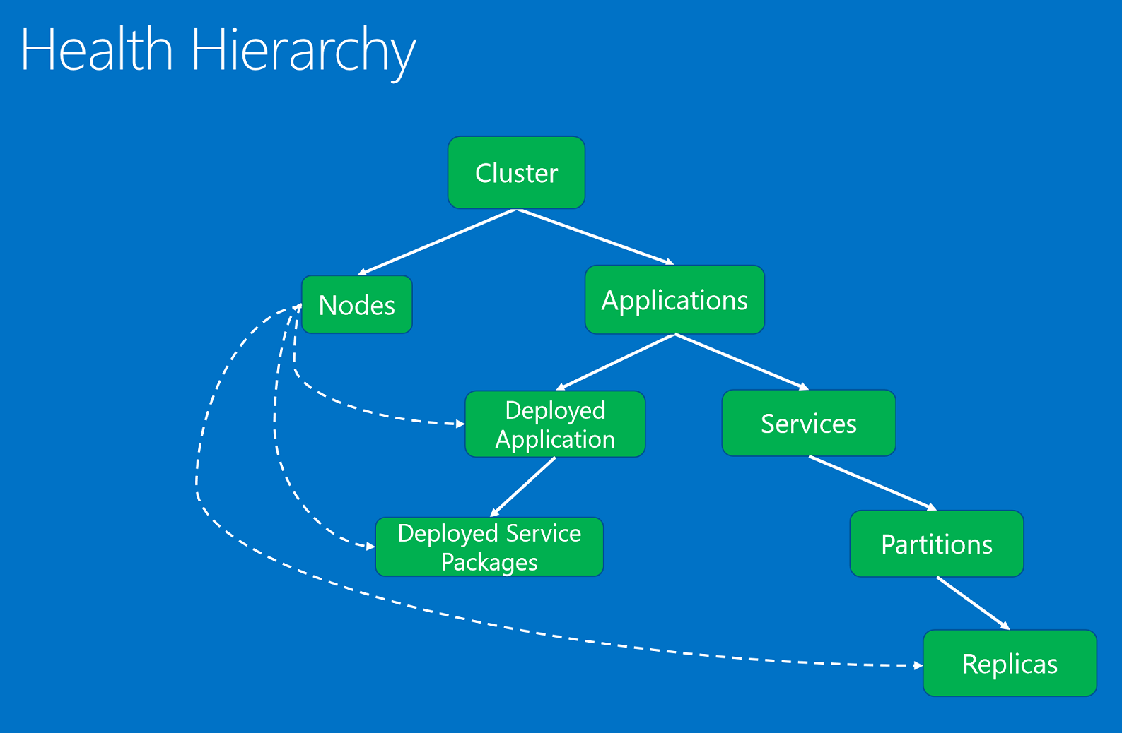
Service Fabric: health status

Slide 41
Service Fabric: health policies
Cluster health policy – defined in cluster manifest
<FabricSettings>
<Section Name="HealthManager/ClusterHealthPolicy">
<Parameter Name="ConsiderWarningAsError" Value="False" />
<Parameter Name="MaxPercentUnhealthyApplications" Value="20" />
<Parameter Name="MaxPercentUnhealthyNodes" Value="20" />
<Parameter Name="ApplicationTypeMaxPercentUnhealthyApplications-ControlApplicationType" Value="0" />
</Section>
</FabricSettings>

Slide 42
Service Fabric: health policies
Application health policy/ Service health policy - defined ApplicationManifest.xml, in the application package
<Policies>
<HealthPolicy ConsiderWarningAsError="true" MaxPercentUnhealthyDeployedApplications="20">
<DefaultServiceTypeHealthPolicy
MaxPercentUnhealthyServices="0"
MaxPercentUnhealthyPartitionsPerService="10"
MaxPercentUnhealthyReplicasPerPartition="0"/>
<ServiceTypeHealthPolicy ServiceTypeName="FrontEndServiceType"
MaxPercentUnhealthyServices="0"
MaxPercentUnhealthyPartitionsPerService="20"
MaxPercentUnhealthyReplicasPerPartition="0"/>
<ServiceTypeHealthPolicy ServiceTypeName="BackEndServiceType"
MaxPercentUnhealthyServices="20"
MaxPercentUnhealthyPartitionsPerService="0"
MaxPercentUnhealthyReplicasPerPartition="0">
</ServiceTypeHealthPolicy>
</HealthPolicy>
</Policies>

Slide 43
Service Fabric: health states
OK. The entity is healthy. There are no known issues reported on it or its children (when applicable).
Warning. The entity experiences some issues, but it is not yet unhealthy (i.e., no unexpected delay is causing any functional issues). In some cases, the warning condition may fix itself without any special intervention, and it is useful to provide visibility into what is going on. In other cases, the warning condition may degrade into a severe problem without user intervention.
Error. The entity is unhealthy. Action should be taken to fix the state of the entity, because it can't function properly.
Unknown. The entity doesn't exist in the health store. This result can be obtained from the distributed queries that merge results from multiple components. These can include the query to get the list of Service Fabric nodes, which goes to FailoverManager and HealthManager, or the query to get the list of applications, which goes to ClusterManager and HealthManager. These queries merge results from multiple system components. If another system component has an entity that has not yet reached the health store or that has been cleaned up from the health store, the merged query will populate the health result with the unknown health state.

Slide 44
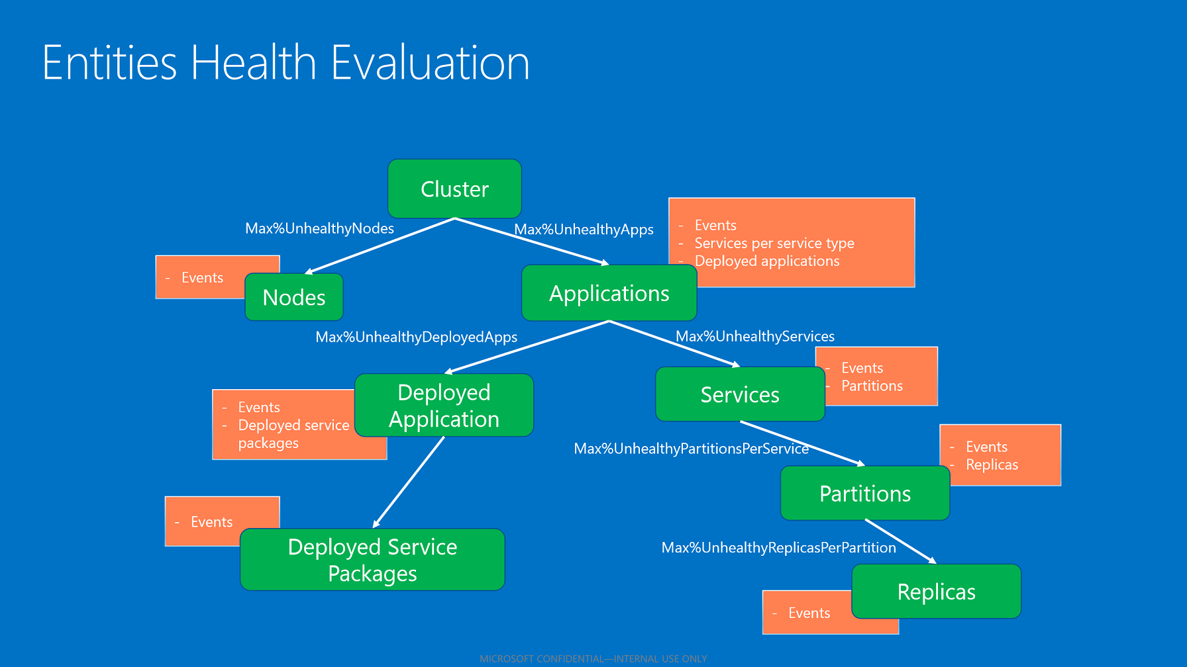
Service Fabric: health status
If all children have OK states -> aggregated state OK.
If children have both OK and warning states -> warning.
If there are children with error states that do not respect the maximum allowed percentage of unhealthy children-> error
If the children with error states respect the maximum allowed percentage of unhealthy children -> warning.

Slide 45
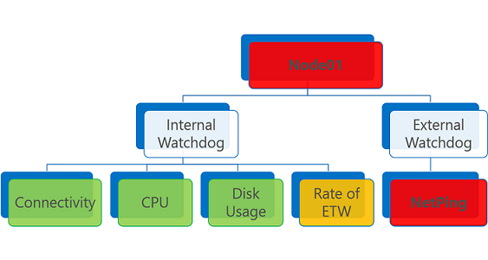
Service Fabric: event monitoring on node
ETW=Event Tracing for Windows

Slide 46
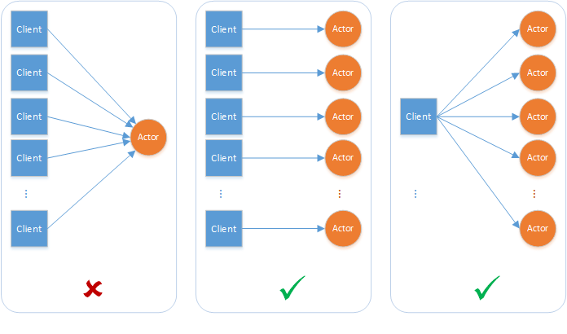
Service Fabric: reliable actors
An actor is an isolated, independent unit of compute and state with single-threaded execution.
When :
Your problem space involves a large number (thousands or more) of small, independent, and isolated units of state and logic.
You want to work with single-threaded objects that do not require significant interaction from external components,
including querying state across a set of actors.
Your actor instances won't block callers with unpredictable delays by issuing I/O operations.
Example

Slide 47
Service Fabric: reliable services
API to build stateless and stateful services. Stateful service store their state in Reliable Collections (such as a dictionary or a queue). Service Fabric provides reliability, availability, consistency, and scalability.
Service lifecycle:
CreateServiceReplicaListeners/CreateServiceInstanceListeners - This is where the service defines the communication stack that it wants to use.
RunAsync - This is where your service runs its business logic. The cancellation token that is provided is a signal for when that work should stop (the cancellation token held by RunAsync() is canceled; then CloseAsync() is called on the communication listeners.
Stateless - A stateless service is one where there is literally no state maintained within the service, or the state that is present is entirely disposable and doesn't require synchronization, replication, persistence, or high availability. RunAsync() of the service can be empty, since there is no background task-processing that the service needs to do. Common example of how stateless services are used in Service Fabric is as a front-end that exposes the public-facing API for a web application. The front-end service then talks to stateful services to complete a user request.
Statefull - A stateful service is one that must have some portion of state kept consistent and present in order for the service to function. stateful services aren't required to store their state externally; Service Fabric takes care of these requirements for both the service code and the service state. For examp service could have a loop inside its RunAsync that pulls requests out of IReliableQueue, performs the conversions listed, and stores the results in IReliableDictionary

Slide 48
Service Fabric: reliable services
When to use Reliable Services APIs :
If any of the following characterize your application service needs, then you should consider Reliable Services APIs:
Provide application behavior across multiple units of state (e.g., orders and order line items).
Application’s state can be naturally modeled as Reliable Dictionaries and Queues.
State needs to be highly available with low latency access.
Application needs to control the concurrency or granularity of transacted operations across one or more Reliable Collections.
Want to manage the communications or control the partitioning scheme for your service.
Your code needs a free-threaded runtime environment.
Your application needs to dynamically create or destroy Reliable Dictionaries or Queues at runtime.
You need to programmatically control Service Fabric-provided backup and restore features for your service’s state*.
Your application needs to maintain change history for its units of state*.

Slide 49
Service Fabric: application concepts
Application Package: A disk directory containing the application type's ApplicationManifest.xml file. References the service packages for each service type that makes up the application type. The files in the application package directory are copied to Service Fabric cluster's image store.
Named Application: After an application package is copied to the image store, you create an instance of the application within the cluster by specifying the application package's application type (using its name/version).
Each application type instance is assigned a URI name like "fabric:/MyNamedApp".
You can create multiple named applications from a single application type.
You can also create named applications from different application types.
Each named application is managed and versioned independently.

Slide 50
Service Fabric: application concepts
Service Type: The name/version assigned to a service's code packages, data packages, and configuration packages.
Defined in a ServiceManifest.xml file, embedded in a service package directory
Service package directory referenced by an application package's ApplicationManifest.xml file.
After creating a named application, you can create a named service from one of the application type's inside cluster
Service Package: A disk directory containing the service type's ServiceManifest.xml file. This file references the code, static data, and configuration packages for the service type.
Named Service: After creating a named application, you can create an instance of one of its service types within the cluster by specifying the service type (using its name/version).
Each service type instance is assigned a URI under its named application's URI like: "fabric:/MyNamedApp/MyDatabase".
Within a named application, you can create several named services.
Each named service can have its own partition scheme and instance/replica counts.

Slide 51
Service Fabric: application concepts
Code Package: A disk directory containing the service type's executable files (typically EXE/DLL files). The files in the code package directory are referenced by the service type's ServiceManifest.xml file. When a named service is created, the code package is copied to the one or more nodes selected to run the named service and then the code starts running. There are two types of code package executables:
Guest executables: Executables that run as-is on the host operating system (Windows or Linux):
Do not link to or reference any Service Fabric runtime files and therefore do not use any Service Fabric programming models.
Unable to use some Service Fabric features such as the naming service for endpoint discovery.
Guest executables cannot report load metrics specific to each service instance.
Service Host Executables: Executables that use Service Fabric programming models by linking to Service Fabric runtime files, enabling Service Fabric features.
Data Package: A disk directory containing the service type's static, read-only data files (typically photo, sound, and video files). The files in the data package directory are referenced by the service type's ServiceManifest.xml file. When a named service is created, the data package is copied to the one or more nodes selected to run the named service. The code starts running and can now access the data files.
Configuration package: everything the same like data package, but configuration files.

Slide 52
Service Fabric: application concepts
Partition Scheme: When creating a named service, you specify a partition scheme. Services with large amounts of state split the data across partitions which spreads it across the cluster's nodes.
Service Fabric offers a choice of three partition schemes:
Ranged partitioning (otherwise known as UniformInt64Partition).
Named partitioning. Applications using this model usually have data that can be bucketed, within a bounded set. Some common examples of data fields used as named partition keys would be regions, postal codes, customer groups, or other business boundaries.
Singleton partitioning. Singleton partitions are typically used when the service does not require any additional routing. For example, stateless services use this partitioning scheme by default.

Slide 53
Service Fabric: application concepts
Service Fabric Services
Stateless:
Use a stateless service when the service's persistent state is stored in an external storage service such as Azure Storage, Azure SQL Database, or Azure DocumentDB.
Use a stateless service when the service has no persistent storage at all.
Stateful:
Use a stateful service when you want Service Fabric to manage your service's state via its Reliable Collections or Reliable Actors programming models.
Specify how many partitions you want to spread your state over (for scalability) when creating a named service.
specify how many times to replicate your state across nodes (for reliability).
Each named service has a single primary replica and multiple secondary replicas.
You modify your named service's state by writing to the primary replica. Service Fabric then replicates this state to all the secondary replicas keeping your state in sync.
Service Fabric automatically detects when a primary replica fails and promotes an existing secondary replica to a primary replica and creates a new secondary replica.

Slide 54
Service Farbic cluster

Slide 55
Service Fabric APIs
Reliable Services SDK
C#
Java (coming soon)
Management APIs
C#, Java, PowerShell, HTTP
Application management (create, upgrade, delete)
Cluster management
Health management
Service discovery
Query

Slide 56
Service Farbic: Application design

Slide 57
Service fabric: connecting from outside

Slide 58
Service development
Reliable Collections
Avoid data corruption. Use immutable objects.
Data must be backwards-compatible.
Reliable Dictionary CountAsync() is expensive
Know your locking semantics!
System
Services will move around and there’s nothing you can do about it.
Honor thy cancellation token.

Slide 59
Service Fabric: Future
Azure
VMSS OS upgrades
Staging for Service Fabric upgrades
Xplat
Linux
Core CLR support
Java and cross-language support
Open source Service and Actor frameworks
Application development
Reliable Collections large store support, Reliable Concurrent Queue
ASP.NET Core 1
Visual Studio, tools, CI/CD
Application certificate management

Slide 60
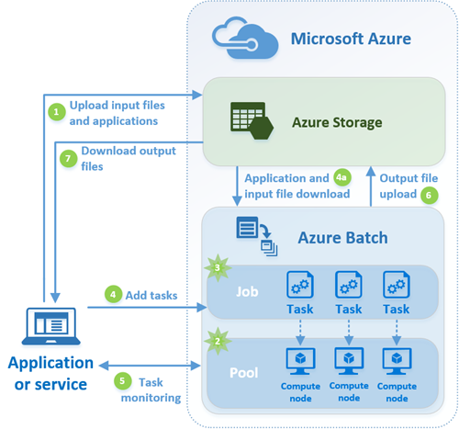
Azure Batch
Workloads that are commonly processed using this technique are:
•Financial risk modeling
•Climate and hydrology data analysis
•Image rendering, analysis, and processing
•Media encoding and transcoding
•Genetic sequence analysis
•Engineering stress analysis
•Software testing
Batch account URL:
https://<account_name>.<region>.batch.azure.com
Application package is .zip which is placed in storage :
Pool application packages are deployed to every node in the pool. Applications are deployed when a node joins a pool, and when it is rebooted or reimaged.
Task application packages are deployed only to a compute node scheduled to run a task, just before running the task's command line

Slide 61
Azure Batch: how it works
Upload the input files and the application that will process those files to your Azure Storage account.
Create a Batch pool of compute nodes in your Batch account ( nodes are the VMs that will execute your tasks):
You specify properties such as the node size, OS and the location in Azure Storage of the application to install when the nodes join the pool (the application that you uploaded in step #1).
Configure the pool to automatically scale
Create a Batch job to run the workload on the pool of compute nodes - when you create a job, you associate it with a Batch pool.
Add tasks to the job
Batch service automatically schedules the tasks for execution on the compute nodes in the pool
Each task uses the application that you uploaded to process the input files.
Before a task executes, it can download the data (the input files) that it is to process to the compute node it is assigned to.
If the application has not already been installed on the node (see step #2), it can be downloaded here instead.
As the tasks run, you can query Batch to monitor the progress of the job over HTTPS. You might be monitoring thousands of tasks running on thousands of compute nodes - query the Batch service efficiently.
6. As the tasks complete, they can upload their result data to Azure Storage. You can also retrieve files directly from compute nodes

Slide 62
Azure Batch: how it works
5. As the tasks run, you can query Batch to monitor the progress of the job and its tasks:
a) Your client application or service communicates with the Batch service over HTTPS
b) You might be monitoring thousands of tasks running on thousands of compute nodes - query the Batch service efficiently.
6. As the tasks complete, they can upload their result data to Azure Storage. You can also retrieve files directly from compute nodes
7.When your monitoring detects that the tasks in your job have completed, your client application or service can download the output data for further processing or evaluation.

Slide 63
VM Scale Sets
all VMs configured the same, VM scale sets are designed to support true autoscale – no pre-provisioning of VMs is required
To increase or decrease the number of virtual machines in a VM scale set, simply change the capacity property and redeploy the template
Typical VM scale set scenarios (like Azure Batch, Service Fabric, Azure Container Service use them ) :
RDP / SSH to VM scale set instances - A VM scale set is created inside a VNET and individual VMs in the scale set are not allocated public IP addresses.

Slide 64
Scale Sets scenarios
RDP / SSH to VM scale set instances - A VM scale set is created inside a VNET and individual VMs in the scale set are not allocated public IP addresses
Connect to VMs using NAT rules - You can create a public IP address, assign it to a load balancer, and define inbound NAT rules which map a port on the IP address to a port on a VM in the VM scale set. For example:
Public IP Port 50000 vmss_0 Port 22
Public IP Port 50001 vmss_1 Port 22
Public IP Port 50002 vmss_2 Port 22
Load balancing to VM scale set instances - If you want to deliver work to a compute cluster of VMs using a "round-robin" approach, you can configure an Azure load balancer with load-balancing rules accordingly.

Slide 65
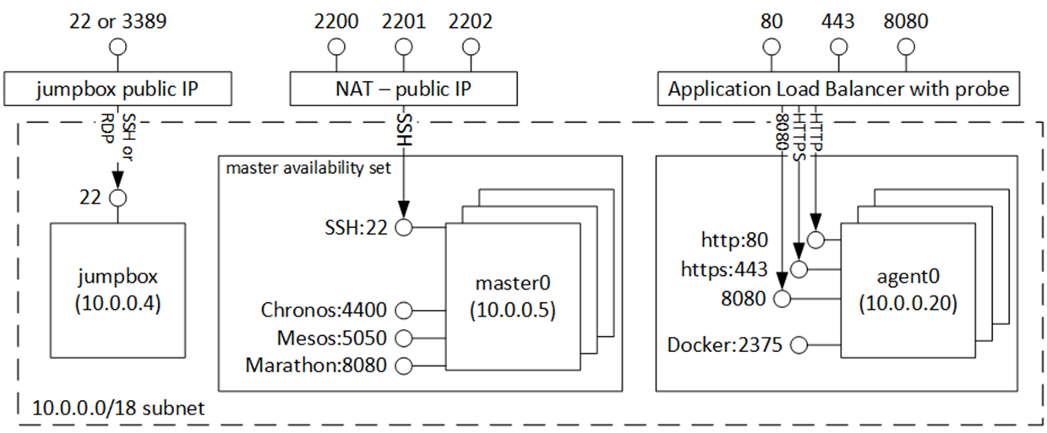
Scale Sets scenarios
Connect to VMs using a "jumpbox" - If you create a VM scale set and a standalone VM in the same VNET, the standalone VM and the VM scale set VMs can connect to one another using their internal IP addresses as defined by the VNET/Subnet.

Slide 66
Scale Sets performance topics
No more than 500 VMs in multiple scale sets per region during a 10 minute period.
Plan for no more than 4096 VMs per VNET.
In one Scale set in can be up to 100VMs
Options for storing data are:
Azure files (SMB shared drives)
OS drive
Temp drive (local, not backed by Azure storage)
Azure data service (e.g. Azure tables, Azure blobs)
External data service (e.g. remote DB)
In case of downscale - virtual machines are removed from the scale set evenly across upgrade domains and fault domains to maximize availability : VMs with the highest id's are removed first

Slide 67
High availability services
DNS level :
Azure DNS
Traffic Manager
Application level:
Azure Internal Load Balancer ( ALB )
Application Getaway

Slide 68
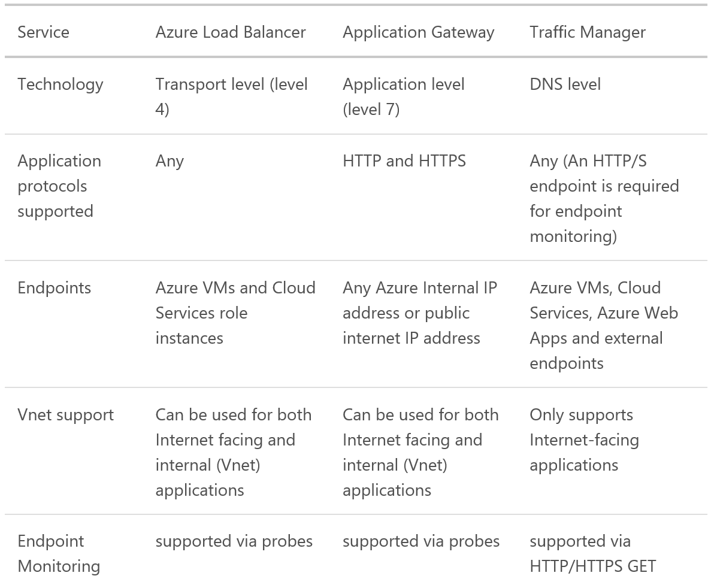
High availability services

Slide 69
Azure DNS
Azure DNS is a hosting service for DNS domains, providing name resolution using Microsoft Azure infrastructure
DNS domains in Azure DNS are hosted on Azure’s global network of DNS name servers. We use Anycast networking so that each DNS query is answered by the closest available DNS server.
Currently only domain delegation is supported ( you can’t buy domain )
Azure DNS supports all common DNS record types, including A, AAAA, CNAME, MX, NS, SOA, SRV, and TX, as well as wildcards.

Slide 70
Azure Traffic Manager
Works on DNS level, best scenarios:
Improve availability of critical applications
Improve responsiveness for high performance applications – allows you to run cloud services or websites in datacenter (any hosting, not limited to Azure .
Upgrade and perform service maintenance without downtime
Combine on-premises and Cloud-based applications – Traffic Manager supports external, non-Azure endpoints enabling it to be used with hybrid cloud and on-premises deployments, including the “burst-to-cloud,” “migrate-to-cloud,” and “failover-to-cloud” scenarios.
Distribute traffic for large, complex deployments – Traffic-routing methods can be combined using nested Traffic Manager profiles

Slide 71
Azure Traffic Manager
Traffic routing methods available in Traffic Manager:
Priority: Select ‘Priority’ when you want to use a primary service endpoint for all traffic, and provide backups in case the primary or the backup endpoints are unavailable. For more information, see Priority traffic-routing method.
Weighted: Select ‘Weighted’ when you want to distribute traffic across a set of endpoints, either evenly or according to weights which you define. For more information, see Weighted traffic-routing method.
Performance: Select ‘Performance’ when you have endpoints in different geographic locations and you want end users to use the "closest" endpoint in terms of the lowest network latency. For more information, see Performance traffic-routing method.

Slide 72

Azure Traffic Manager: priority routing

Slide 73
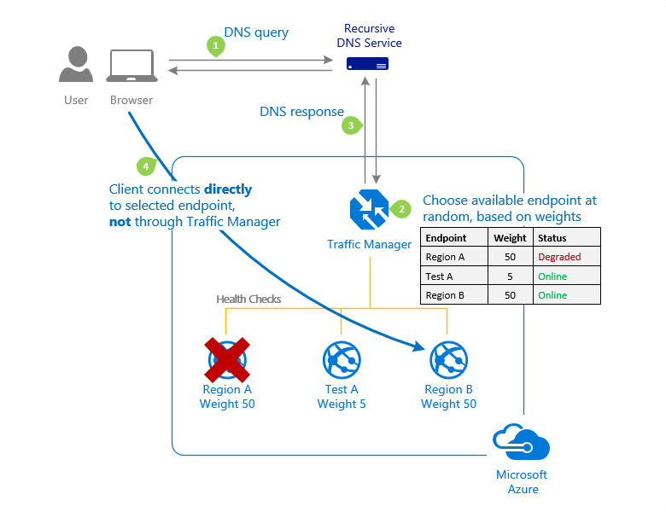
Azure Traffic Manager: weigthed routing

Slide 74
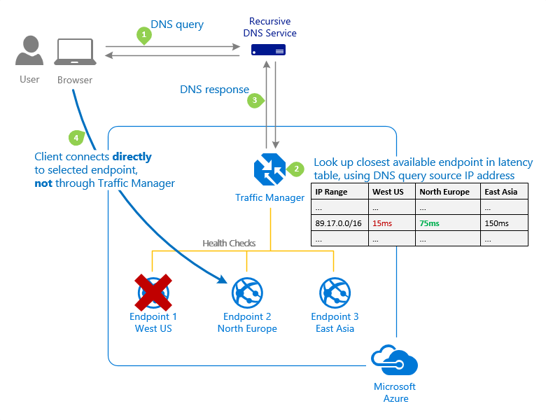
Azure Traffic Manager: performance routing

Slide 75
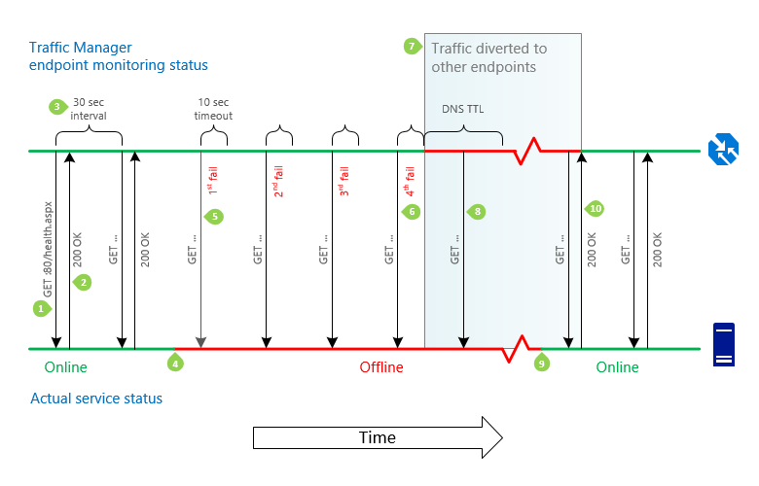
Azure Traffic Manager: example

Slide 76
Azure Load Balancer
Azure Load Balancer delivers high availability and network performance to your applications. It is a Layer 4 (TCP, UDP) load balancer that distributes incoming traffic among healthy instances of services defined in a load-balanced set. o
Azure Load Balancer configuration:
Load balance incoming Internet traffic to virtual machines. This configuration is known as Internet-facing load balancing.
Load balance traffic:
betvirtual machines in a virtual network
between virtual machines in cloud services
between on-premises computers and virtual machines in a cross-premises virtual network ( internal load balancing )
Forward external traffic to a specific virtual machine.
All resources in the cloud need a public IP address to be reachable from the Internet. Within the cloud infrastructure, Microsoft Azure uses non-routable IP addresses for its resources. Azure uses network address translation (NAT) with public IP addresses to communicate to the Internet.

Slide 77
Azure Load Balancer features
Hash-based distribution :
By default, it uses a 5-tuple (source IP, source port, destination IP, destination port, and protocol type) hash to map traffic to available servers.
Stickiness only within a transport session.
Packets in the same TCP or UDP session will be directed to the same instance behind the load-balanced endpoint.
When the client closes and reopens the connection or starts a new session from the same source IP, the source port changes. This may cause the traffic to go to a different endpoint in a different datacenter.
Port forwarding
Automatic reconfiguration during scale up/down
Service monitoring by probes:
Guest agent probe (on PaaS VMs only): utilizes the guest agent inside the virtual machine – check to HTTP 200
HTTP custom probe: Probe your endpoint on instance each 15 sec for TCP ACK or HTTP 200 within the timeout period.
TCP custom probe: relies on successful TCP session establishment to a defined probe port.

Slide 78
Azure Application Gateway
Application Gateway currently supports layer-7 application delivery for the following:
HTTP load balancing
Cookie-based session affinity
Secure Sockets Layer (SSL) offload
URL-based content routing
Multi-site routing
HTTP layer 7 load balancing is useful for:
Applications that require requests from the same user/client session to reach the same back-end virtual machine.Examples of these applications would be shopping cart apps and web mail servers.
Applications that want to free web server farms from SSL termination overhead.
Applications, such as a content delivery network, that requires multiple HTTP requests on the same long-running TCP connection to be routed or load balanced to different back-end servers.
Application Gateway available in 3 sizes : Small ( on for dev/qa ), Medium, Large.

Slide 79
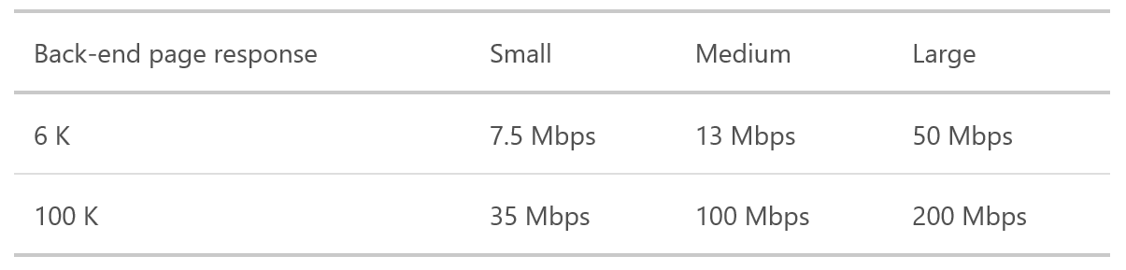
Azure Application Gateway
The following table shows an average performance throughput for each application gateway instance:

Slide 80
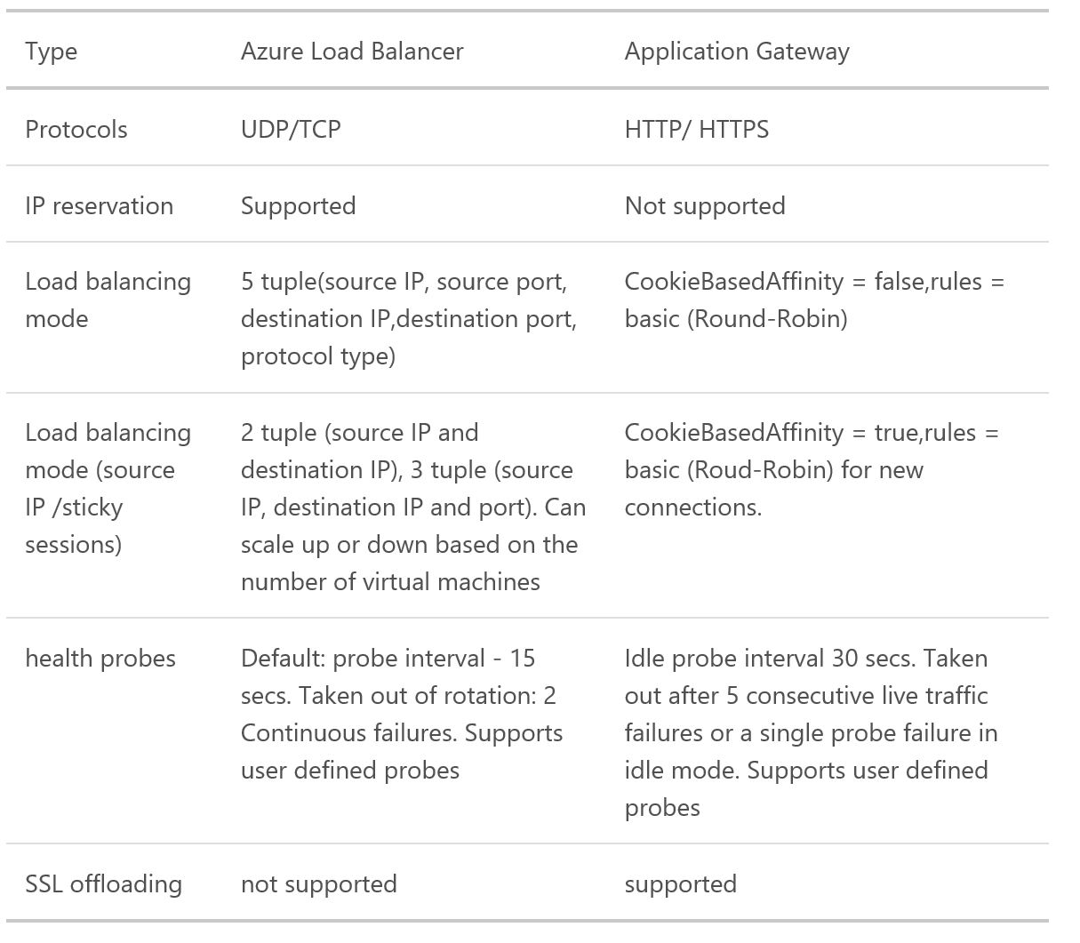
Application Gateway vs Load Balancer

Slide 81
Compute High Availability:Managed Disks
Simpler Service Management
No storage account management
No account limits per subscription
Better custom image management
Fixed disk sizes
Reliability Improvements
Availability Set isolation: Disks in different Storage clusters for FDs
No account IOPS limit related crashes
42
500
41
500
20K IOPs
40
Availability Set
Fault Domains: 3
…
…
500
2
…
SQL1
FD:1
SQL2
FD:2
SQL3
FD:3
20K IOPs
1
500
VMs
500
Disk Service
Disk Resource
Provider
Blob1
Blob2
Blob3
Disk Resource
Provider Storage Accounts
Storage Cluster FD1
Storage Cluster FD2
Storage Cluster FD3
Notes:
Availability set != AZs

Slide 82
Cool Storage
Blob REST API
New tier for blob (object) storage
For high volume infrequently accessed data
Same API and durability; similar latency
Pricing to match workload
Hot: Lower access costs
Cool: Lower per GB prices
Switch account tiers as needed
No charge for Hot to Cool switch
Future – Object level switch with automatic policy based management
Blob REST API
Blob Storage Account – Cool
Blob Storage Account – Cool
1c/GB/mo
1c/GB Reads
0.25c/GB Writes
2x Per Tx cost
Blob Storage Account – Hot
2.4c/GB/mo
No R/W cost
Per Tx cost
Blob Storage Account – Hot

